Slide 1
Molecular Dynamics Simulations applied to ionic solids

Slide 2
Structure
Overview
Forces
Ewald-Summation/Particle-Mesh-Ewald
LJ-Potential
Obtaining Forces
Trajectory
Integrator
Thermostat
Analysis

Slide 3
Overview
Simple Representation
Integrator
Positions x
φ(x)
Forces f
f = - ∇φ
Potential φ

Slide 4
Overview
Detailed Representation
Positions x_{t}
Verlet / CLL
Neighbors
Total Potential φ_{tot}
-∇φ
Point charges
Forces f
LJ-Potential φ_{LJ}
Velocity Verlet
short ranged potential φ_{S}
Short ranged ρ_{S}
Cutoff
Charge Distribution ρ
Thermostat+
Long ranged ρ_{L}
FFT, Poisson Equation, inverse FFT
Long ranged potential φ_{L}
New Positions x_{t+1}

Slide 5
Arbeitsteilung Vorschlag
3 People
Verlet / CLL
2 People
Positions x_{t}
Neighbors
Total Potential φ_{tot}
-∇φ
Point charges
Forces f
LJ-Potential φ_{LJ}
Velocity Verlet
short ranged potential φ_{S}
Short ranged ρ_{S}
Cutoff
Charge Distribution ρ
Thermostat+
Long ranged ρ_{L}
FFT, Poisson Equation, inverse FFT
Long ranged potential φ_{L}
New Positions x_{t+1}

Slide 6
Detailierterer Vorschlag zur Arbeitsverteilung
Aufgaben:
Neighbor-List (1P)
Ewald Summation (2P)
Thermostat (1P)
Integrator(1P)
Allgemeiner Vorgang:
Code schreiben der funktioniert
Code verbessern (Rechenaufwand, Stabilität etc. )

Slide 7
Neighbor Search
Verlet or Cell-Linked lists, see slides

Slide 8
Ewald Summation
Required: FFT, Solving Poisson Equation in Fourier Space, inverse FFT, Cutoff
FFT, inverse FFT: lets use packages available to us
Poisson Equation: see Script, Exercises etc.
Cutoff: lets use a switch Cutoff

Slide 9
Differentiating the Potential
If anybody knows how to treat this guy -∇φ, would be great if you‘d let us know.
Team Purple should try to obtain φ in a form that can be differentiated easily.
Team Orange can try to implement the actual differentiation

Slide 10
Thermostat
Thermostat | Correct Ensemble | Deterministic | Ergodic
Velocity Rescaling | (really bad) | ✓ | ✓
Berendsen temperature coupling | ✓ |  | ✓
Velocity rescaling temperature coupling |  | ✓ | ✓
Nosé-Hoover thermostat | ✓ | ✓
Source: „Molecular Dynamics Simualtion“, B. Keller 2015. Vorlesungsskript
More Information:
Chapter 4 from D. Frenkel, B. Smit „Understanding Molecular Simulation: From Algorithms to Applications“, Academic Press, 2002
Berk Hess, David van der Spoel, Erik Lindahl, „Gromacs User Manual, Version 4.6.5“, The GROMACS developement teams at the Royal Institute of Technology and Uppsala University, Sweden
Philippe H. Hünenberger, „Thermostat Algorithms for Molecular Dynamics Simulations“, Adv. Polym. Sci. 173(2005), pp. 105D109

Slide 11
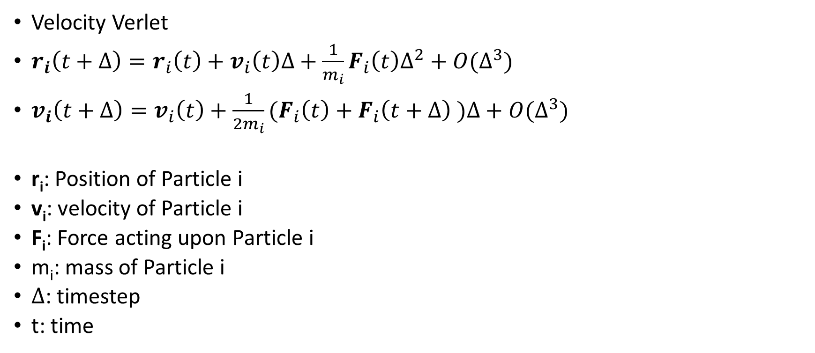
Integrator
Velocity Verlet
$r_{i}\left(t+∆\right)=r_{i}\left(t\right)+v_{i}\left(t\right)∆+\frac{1}{m_{i}}F_{i}\left(t\right)∆^{2}+O(∆^{3})$
$v_{i}\left(t+∆\right)=v_{i}\left(t\right)+\frac{1}{{2m}_{i}}{(F}_{i}\left(t\right)+F_{i}\left(t+∆\right) )∆+O(∆^{3})$
r_{i}: Position of Particle i
v_{i}: velocity of Particle i
F_{i}: Force acting upon Particle i
m_{i}: mass of Particle i
Δ: timestep
t: time

Slide 12
Open Questions
Identify Optimal Crystal Structure from Trajcetories (Symmetry)
Thermodynamic Data from Trajectories?
e.g. Lattice Energy, Phase Change Energy, Phasediagramms…
Wether to use Velocity-Verlet Integrator + Thermostat or Langevin Dynamics instead
Testfunctions !?

